Slide 1
ORGANIZATIONAL BEHAVIOUR

Slide 2
SPADEWORK

Slide 3
WHAT IS MANAGEMENT ?
Management is the process of getting work done effectively and efficiently with and through other people.
Managerial Activities
Make decisions
Allocate resources
Direct activities of others to attain goals

Slide 4
FUNCTIONS OF MANAGEMENT
Planning
Organizing
Management
Functions
Controlling
Leading

Slide 5
PLANNING
A process that includes defining goals, establishing strategy, and developing plans to coordinate activities.

Slide 6
Organizing
Determining what tasks are to be done, who is to do them, how the tasks are to be grouped, who reports to whom, and where decisions are to be made.

Slide 7
LEADING
A function that includes motivating employees, directing others, selecting the most effective communication channels, and resolving conflicts.

Slide 8
Controlling
Monitoring activities to ensure they are being accomplished as planned and correcting any significant deviations.

Slide 9

WHERE DO MANAGERS WORK?
An organization is a consciously coordinated social unit composed of two or more people that functions on a relatively continuous basis to achieve a common goal or set of goals.

Slide 10
MANAGERIAL ROLES
Interpersonal
Informational
Decisional

Slide 11
MANAGEMENT SKILLS
Technical Skills
Human Skills
Conceptual Skills

Slide 12
LUTHANS AND CO STUDIES
Effective Versus Successful Managerial Activities

Slide 13
MANAGERIAL ACTIVITIES
Traditional management
  Decision making, planning, and controlling
Communication
  Exchanging routine information and processing paperwork
Human resource management
  Motivating, disciplining, managing conflict, staffing, and training
Networking
  Socializing, politicking, and interacting with others

Slide 14
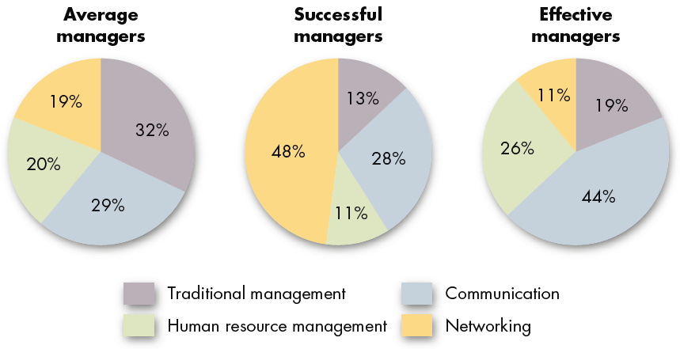
ALLOCATION OF ACTIVITIES BY TIME

Slide 15
Traditional Management
Communication
Managerial Activities
Human Resource Management
Networking
People Skills

Slide 16
Activity Type | Traditional Management | People Skills
 |  | Communication | Human Resource | Networking | Total
Manager Type
Average | 32 | 29 | 20 | 19 | 68
Successful | 13 | 28 | 11 | 48 | 87
Effective | 19 | 44 | 26 | 11 | 81

Slide 17
People Skills
Organizational Behaviour

Slide 18
ORGANIZATIONAL BEHAVIOUR
Organization
Behaviour

Slide 19
ORGANIZATION
Gary Johns says…
Organisations are social interventions for accomplishing goals through group efforts.

Slide 20
BEHAVIOUR
Behaviour is anything that the human does.
It is response to stimulation; thus it is any response or reaction of an individual.
Behaviour is predictable.

Slide 21
BASIC ASSUMPTIONS
Individual differences
A Whole person
Caused behaviour
Human dignity
Organizations are social systems
Mutuality of Interest

Slide 22
DEFINING ORGANIZATIONAL BEHAVIOR (OB)
What they say…

Slide 23
LUTHANS SAYS…
Organizational behaviour is directly concerned with the understanding, prediction, and control of human behaviour in organisations.

Slide 24
ROBBINS’ WORDS…
A field of study that investigates the impact that individuals, groups, and structure have on behavior within organizations, for the purpose of applying such knowledge towards improving an organization’s effectiveness.

Slide 25
ACCORDING TO KEITH DAVIS…
Organizational behaviour is an academic discipline concerned with understanding and describing human behaviour in an organizational environment. It seeks to shed light on the whole complex human factor in organizations by identifying causes and effects of that behaviour.

Slide 26
OB REPLACES INTUITION WITH SYSTEMATIC STUDY

Slide 27
INTUITION
(Gut feelings)
A feeling not necessarily supported by research/based on scientific evidence.

Slide 28
SYSTEMATIC STUDY
Looking at relationships, attempting to attribute causes and effects, and drawing conclusions based on scientific evidence.
Systematic study provides a means to predict behaviors.

Slide 29
Facts
Preconceived
Notions
(Intuition)
≠

Slide 30
Topics under OB
Motivation
Leader behaviour and power
Interpersonal Communication
Group structure and processes
Learning (value of mistakes)
Attitude development and perception
Change processes
Conflict
Work design
Work stress

Slide 31
NATURE OF OB
Interdisciplinary approach
An applied science
Behavioural approach to management
Concern with environment
Scientific method
Contingency approach
A systems approach
Value-centred

Slide 32
LEVELS OF ANALYSIS
Individual behaviour
Inter-personal behaviour
Group behaviour and group dynamics
Organizational issues
Environmental issues

Slide 33
CONTRIBUTING DISCIPLINES
Psychology
Sociology
Social psychology
Anthropology
Political science
Medicines
Semantics

Slide 34
WHY STUDY OB?
Helping individuals understanding themselves and others;
Functional improvement in productivity, job satisfaction and OCB and reduction in absenteeism, turnover and deviant workplace behaviour
Helping managers in getting the work done effectively;

Slide 35
WHY STUDY OB? (Contd…)
Effective management of human resources;
Developing work-related behaviour and job satisfaction;
Building motivating climate;
Building cordial industrial relations;
Marketing management (consumer behaviour)

Slide 36
AN OB MODEL

Slide 37
MODEL
An abstraction of reality
A simplified representation of some real-world phenomenon

Slide 38
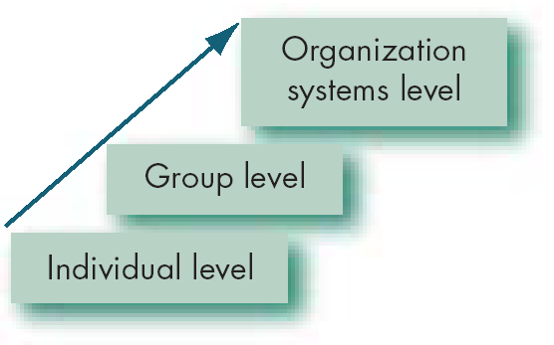
LEVELS IN AN OB MODEL

Slide 39
OB MODEL
Personality
Perception
Learning
Attitude and values
Motivation
Individual
Behaviour
Group dynamics
Leadership
Power and politics
Communication
Conflict
Group
Behaviour
Organizational
Effectiveness
Organization culture
HR policies and practices
Work stress
Organizational change
and development
Organization

Slide 40
NEW CHALLENGES FOR OB MANAGERS
Improving people skills
Empowering people
Stimulating innovation and change
Coping with “temporariness”
Working in networked organizations

Slide 41
NEW CHALLENGES FOR OB MANAGERS
(Contd…)
Helping employees balance work/life conflicts
Improving ethical behavior

